Slide 1

AI-Driven Mental Health Platform Pitch Presentation
Title: AI-Driven Mental Health Platform
Subtitle: Real-time mental health support for students and professionals
Team Name : Jay-Maharashtra
Students : Rishabh Santosh Shenoy
Date : 25-12-2024

Slide 2

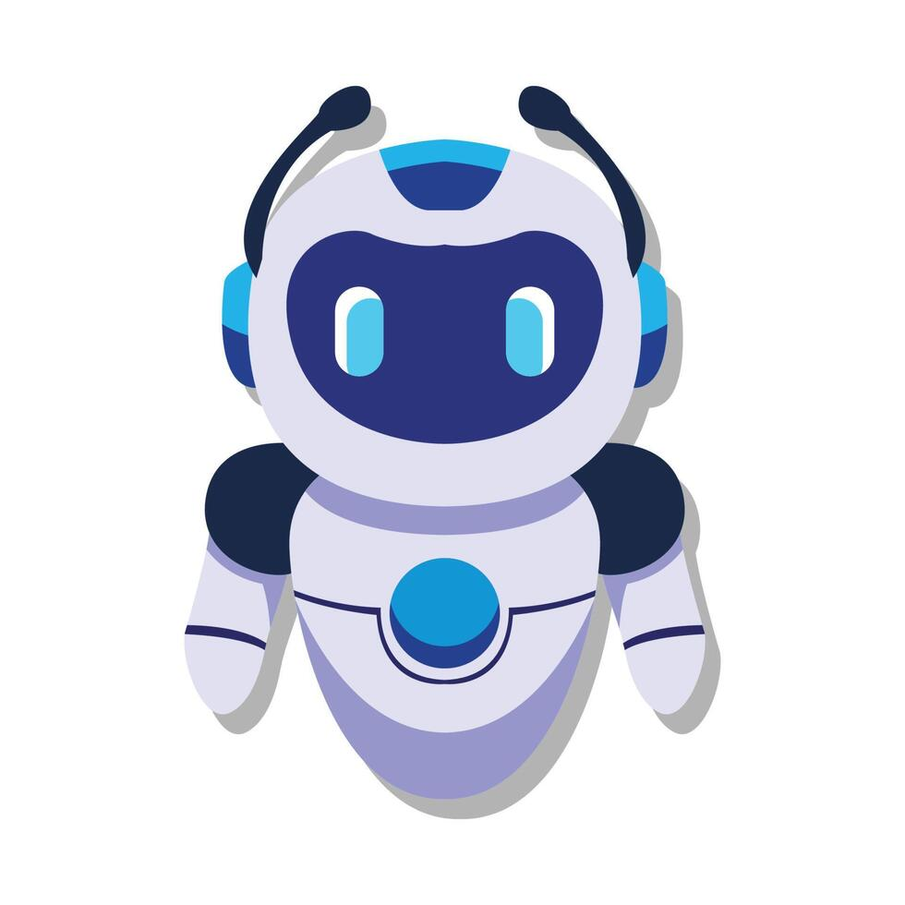
Basic Idea of this project
Target Audience : Designed for students and working professionals, our AI-powered chatbot provides real-time mental health support tailored to individual needs. By integrating advanced natural language processing and emotional intelligence, it ensures empathetic interactions, offering a safe space for users to express themselves without judgment. Its intuitive design fosters meaningful conversations, making mental health support accessible anytime, anywhere.
Objective : The chatbot’s standout feature is its ability to provide context-specific advice by understanding users’ work schedules and academic calendars. Whether it’s managing stress before exams or balancing work-life commitments, the chatbot offers practical, actionable insights. It identifies patterns of stress and burnout, proactively suggesting wellness practices like mindfulness exercises, time management tips, or simply encouraging breaks.
Key Features : This platform goes beyond traditional chatbots by prioritizing user privacy and confidentiality, creating a secure environment for personal discussions. With its focus on mental well-being, it empowers users to build resilience, fostering healthier, more productive lives.

Slide 3
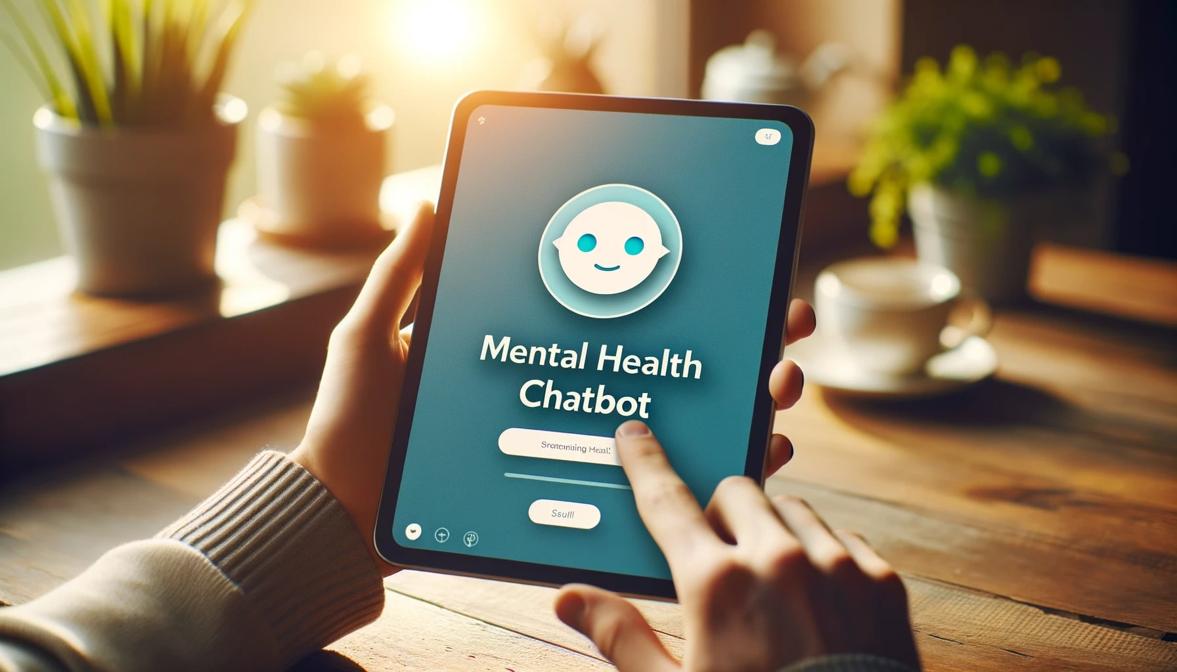
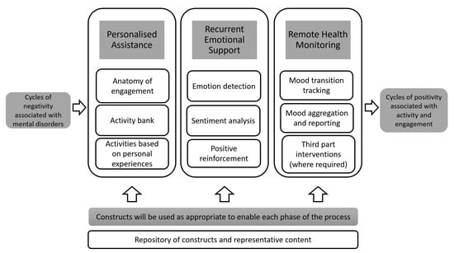
The Problems To be targeted:
Mental Health Support is Expensive and Inaccessible Mental health services often come with significant financial barriers, making them inaccessible to many students and professionals. Therapy sessions, consultations, and wellness programs are costly and frequently limited by geographical availability.
Existing Apps Lack Personalization Most mental health apps offer generic advice that fails to resonate with individual needs. These platforms often neglect the unique challenges faced by users, providing one-size-fits-all solutions that lack depth and relevance.
Market Gap: Lack of Schedule Integration No existing mental health solutions effectively integrate user schedules into their support systems. Apps fail to consider factors like academic deadlines or demanding work hours, resulting in poorly timed advice.

Slide 4
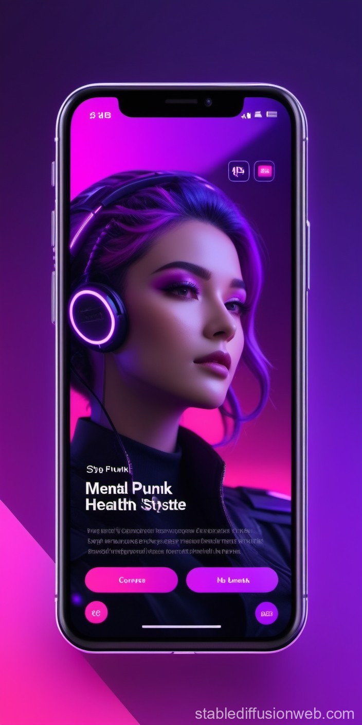
Current Competitors of ai-driven mental health chatbots in the market :
Calm chatbot : Calm is a leading meditation and sleep app that focuses on mental wellness through guided meditations, sleep stories, breathing exercises, and relaxation techniques. With its extensive library of content tailored to stress management, focus improvement, and better sleep, Calm appeals to individuals seeking daily mental health maintenance. It is subscription-based and widely praised for its user-friendly interface and celebrity-narrated sleep stories, but it primarily focuses on generalized wellness rather than personalized, context-specific support.
Wysa chatbot : Wysa is an AI-powered mental health chatbot designed to provide emotional support and self-help resources. Using techniques based on Cognitive Behavioral Therapy (CBT), mindfulness, and motivational interviewing, Wysa engages users in empathetic, anonymous conversations. It also offers mood tracking and journaling features to monitor emotional patterns. While Wysa excels in offering privacy and conversational mental health support, its effectiveness is limited to general mental health issues and does not consider specific user schedules or real-time contextual challenges.

Slide 5
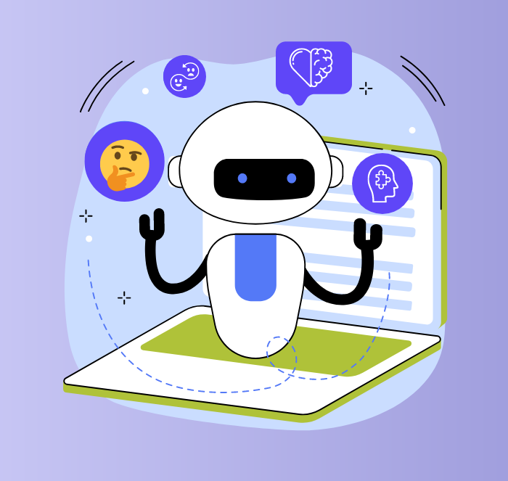
The approach towards this project :
We have developed an AI-powered chatbot designed to deliver real-time, empathetic, and personalized mental health support. Trained on a large emotional dataset, the chatbot ensures meaningful and compassionate conversations tailored to users' unique challenges.
To enhance accessibility, the platform provides free live chat sessions, breaking financial barriers and ensuring mental health support is available to everyone, regardless of their circumstances. This approach combines advanced AI capabilities with a commitment to inclusivity and care.
Competitors: While popular platforms like Calm and Wysa offer mental health resources, they focus on generalized advice or require paid subscriptions, limiting their reach and personalization.
Our Edge:
Integration with Work and Academic Schedules: Unlike competitors, our chatbot provides advice tailored to users’ specific schedules, addressing challenges like exam stress or workload management.
Real-Time, Free AI-Assisted Live Chat: We offer instant, empathetic support without any cost, ensuring accessibility for students and professionals alike.
Personalized Advice for Immediate Relief: The chatbot identifies emotional triggers and stressors to deliver actionable and timely support, creating a truly individualized experience.

Slide 6
Problems vs solution covered by our project :
Problems in current existing bots
Solutions covered by our bot
Ensuring AI is Empathetic and Effective : AI struggles to provide genuine emotional support, often lacking empathy. These models work on one fit for all approach , and lacks personalized treatments.
Scaling the Platform While Maintaining Quality Rapid user growth risks compromising service quality.
Solution 1 : Collaborated with psychologists to train the AI on a comprehensive emotional dataset, enhancing its ability to respond compassionately and effectively to users’ mental health concerns.
Solution: Deployed a robust, cloud-based architecture to ensure seamless scalability, enabling the platform to handle increased traffic while maintaining consistent performance and reliable mental health support for all users.

Slide 7
Our goals :
Short Term Goals
Long Term Goals
Video Sessions with Certified Therapists: Introduce live video sessions to connect users with licensed mental health professionals for more personalized and in-depth support. This will bridge the gap between AI-based assistance and human expertise, offering a hybrid model of care.
Multilingual Support for Global Reach: Expand language options to include regional and international languages, ensuring inclusivity and accessibility for diverse users worldwide. This feature will empower individuals from various linguistic backgrounds to seek mental health support comfortably.
Collaboration with Educational Institutions and Corporates:
Partner with schools, colleges, and organizations to integrate the chatbot into their wellness programs. These collaborations will foster mental health awareness and provide proactive, accessible support tailored to specific academic and workplace environments.
Integration of Wearable Device Data: Leverage data from fitness trackers and wearables to enhance insights into users' physical and mental health. This integration will enable early detection of stress and fatigue, providing timely, personalized interventions for improved well-being.

Slide 8
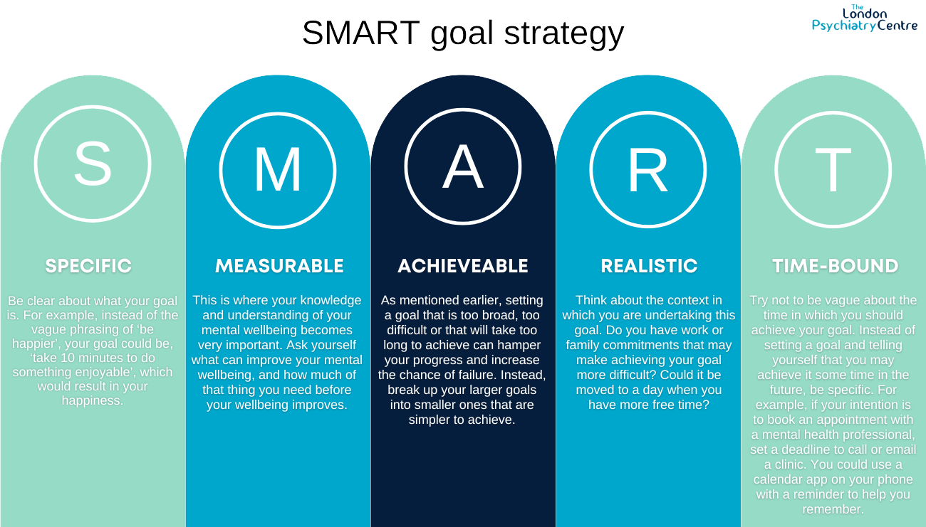

Slide 9


Market potential for our project :
Market Size: The global mental health market is rapidly growing, with projections estimating it will reach $560 billion by 2030. This growth highlights the increasing demand for accessible, effective, and innovative mental health solutions worldwide.
Target Audience: Our primary focus is on the 1 billion+ students and working professionals globally who face mental health challenges due to academic pressures, work-related stress, and lifestyle demands. This underserved segment represents a significant opportunity for tailored mental health support.
Competitive Advantage: Unlike existing platforms, our solution offers a unique integration of work and academic schedules, providing users with timely, personalized advice. This approach, coupled with real-time support and contextual interventions, sets us apart in the competitive landscape.

Slide 10
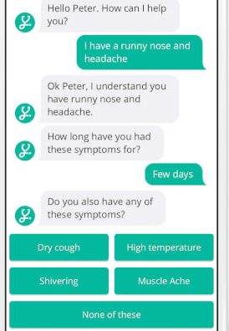
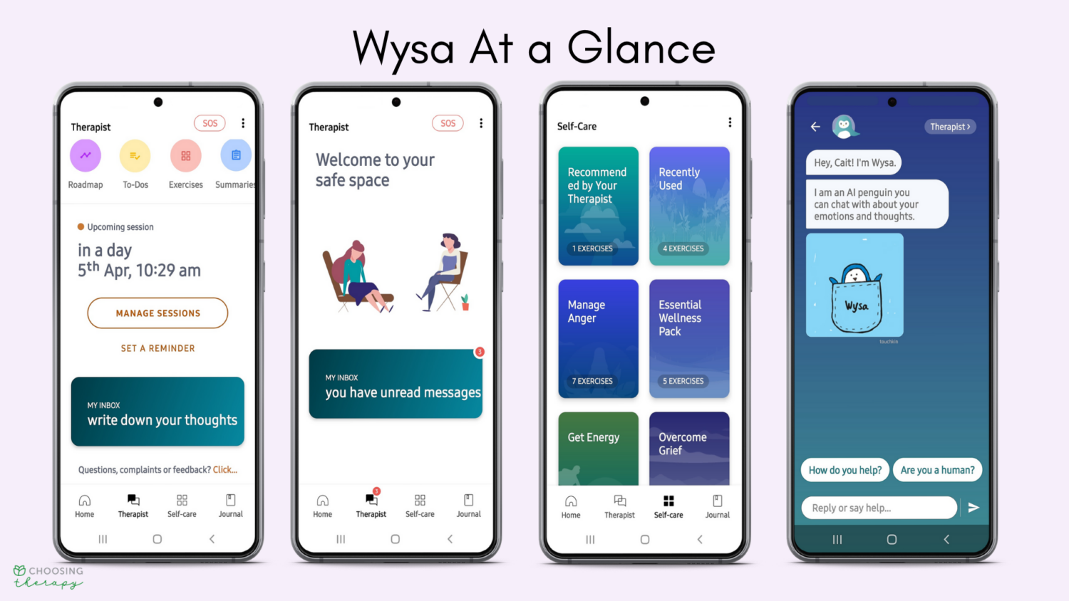
Demonstration of our project (on building phase ) :

Slide 11
Conclusion :
Why Us? We offer a unique solution that addresses a critical unmet need in the mental health space. By combining personalized, schedule-aware support with free, real-time assistance, we redefine how mental health care is delivered.
Our approach is scalable, innovative, and impactful, designed to make mental health support accessible to millions. With our platform, we aim to empower students and professionals to manage stress and achieve mental well-being effectively.
Call to Action: Join us in revolutionizing mental health support. Together, we can create a healthier, happier world, where no one feels alone in their mental health journey. Let’s make a difference—one conversation at a time.
Any questions , feel free to ask !! ☺

Slide 12
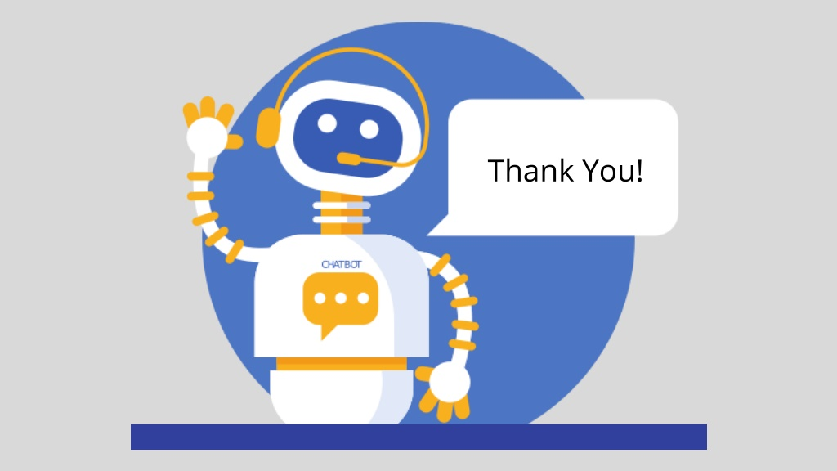
Thank you !! Please support this project and build a better future for all these people

